Slide 1
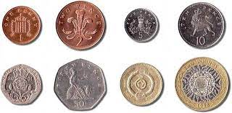
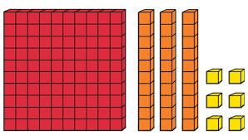
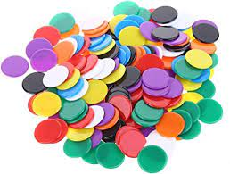
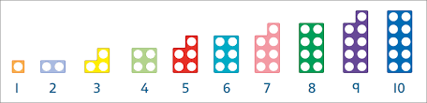
Welcome to the Year 2 Maths Parents Workshop.

Slide 2
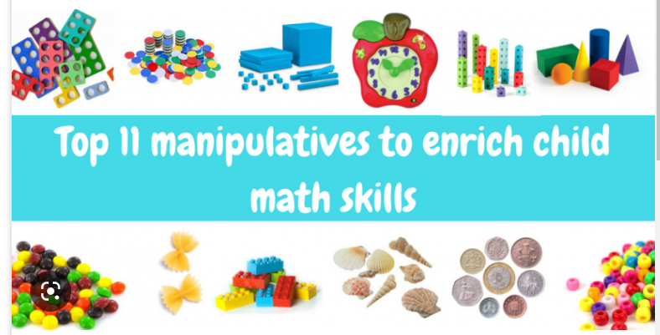

Slide 3
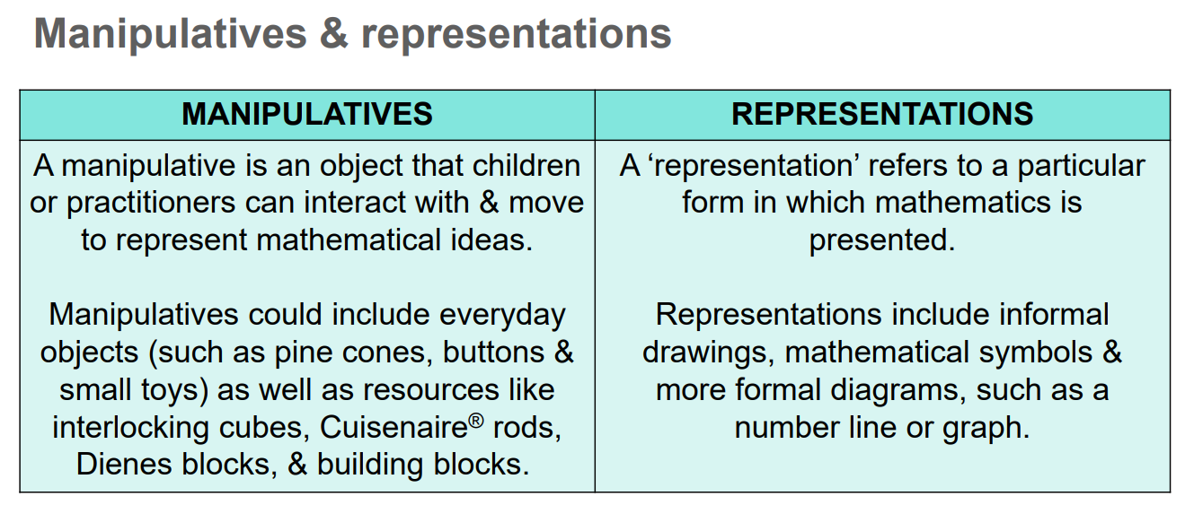
What are manipulatives and representations?

Slide 4
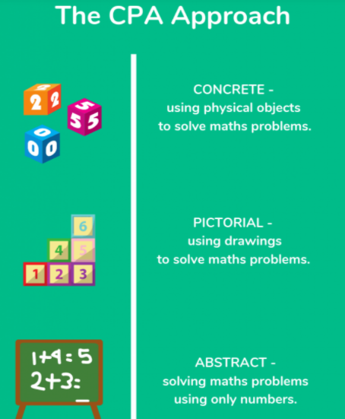
Concrete, pictorial, abstract.
Pupils achieve a much deeper understanding if they don’t have to resort to rote learning and are able to solve problems without having to memorise.
The abstract nature of maths can be confusing for children, but through the use of concrete materials they are able to ‘see’ and make sense of what is actually happening.
Previously, there has been the misconception that concrete resources are only for learners who find maths difficult. In fact concrete resources can be used in a great variety of ways at every level. All children, regardless of ability, benefit from the use of practical resources in ensuring understanding goes beyond the learning of a procedure.

Slide 5
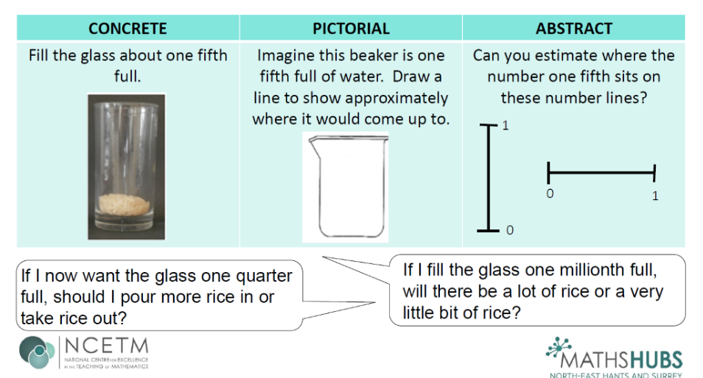
An example for capacity…

Slide 6

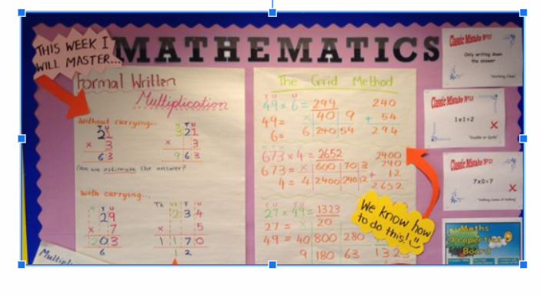
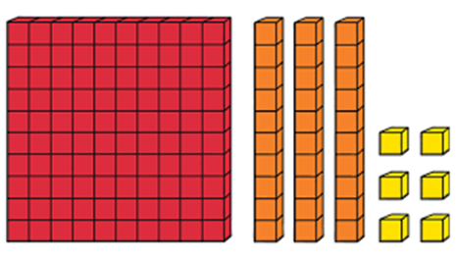
How do we support the children?
Modelling the
Tasks under the visualiser.
Modelling using the manipulatives.
Flipcharts in the lesson and then added to the learning walls.

Slide 7
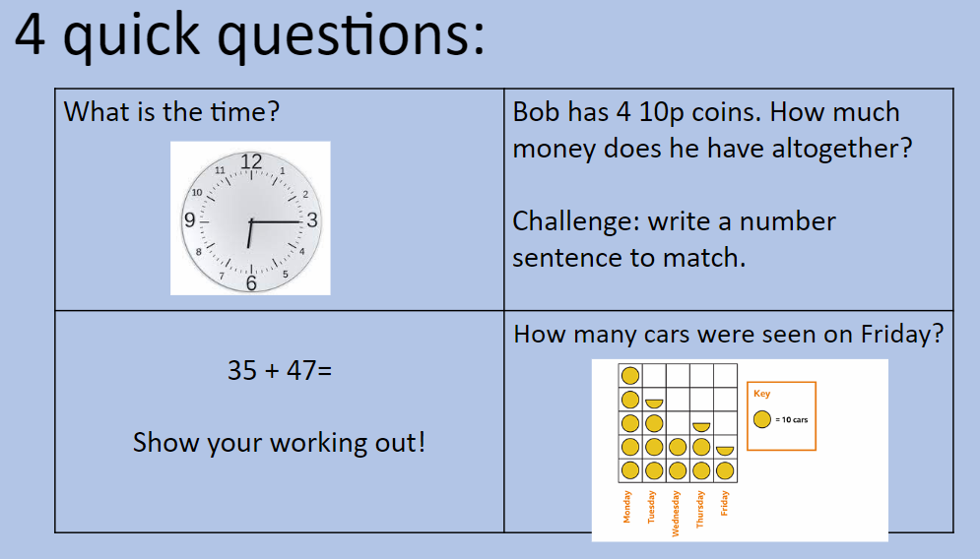
How we start every lesson…

Slide 8
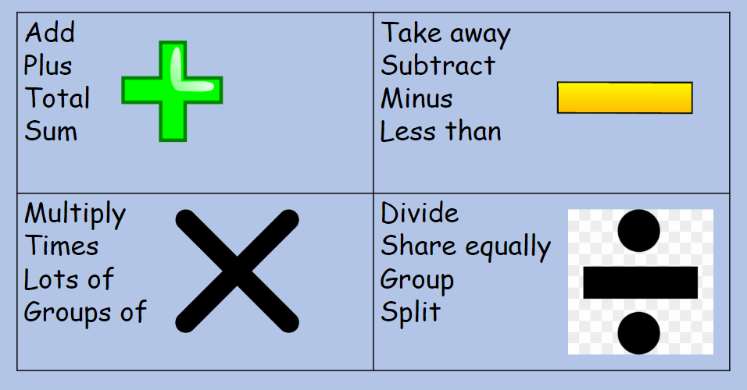
Focus for today is the 4 operations…

Slide 9
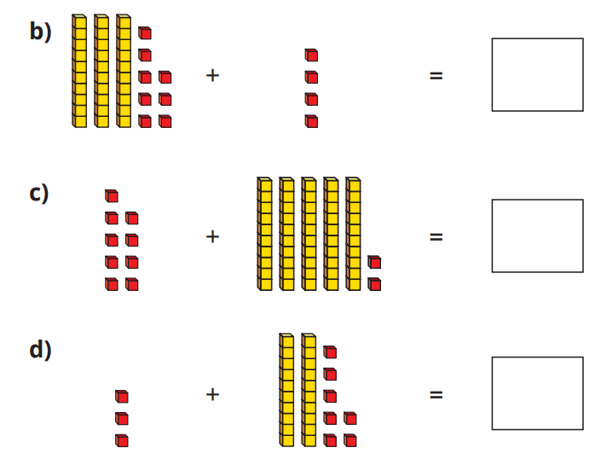
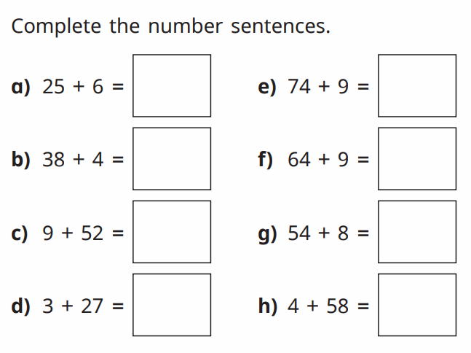
Examples of Adding questions…
34 + 38 =
58 + 33 =
73 + 27 =
14 + 56 =
45 + 29 =

Slide 10
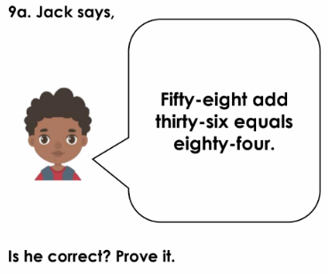
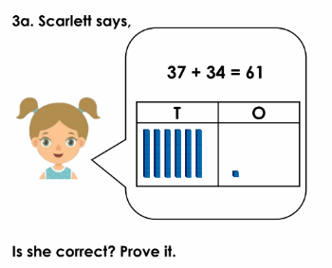
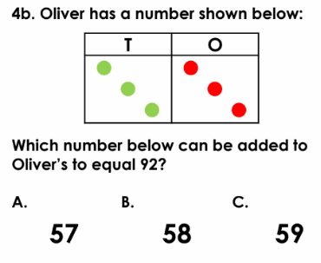
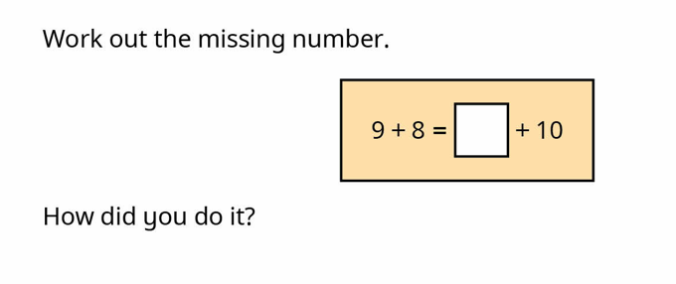
Problem solving and reasoning questions linked to addition…

Slide 11
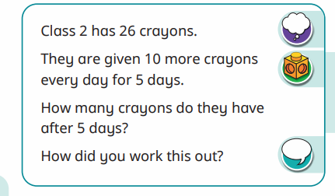
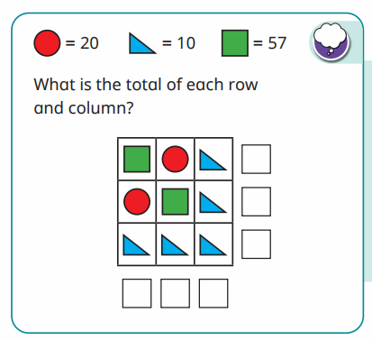

Slide 12
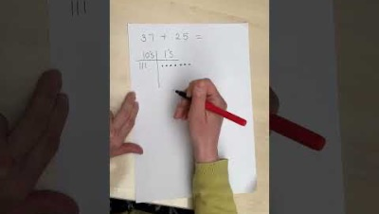
Video explaining addition strategies
Click here to view the view the video in YouTube: https://youtu.be/B48JrZ5hrWw

Slide 13
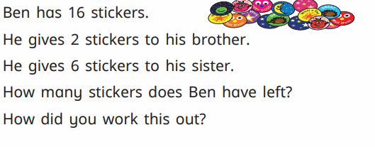
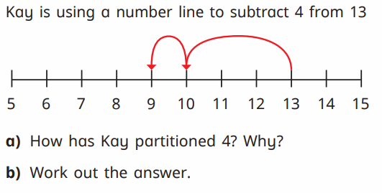
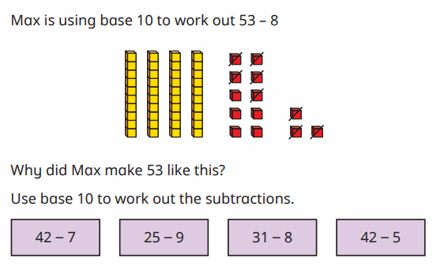
Examples of subtraction questions…
33 - 28 =
35 - 19 =
46 - 17 =
53 - 33 =
56 - 26 =

Slide 14
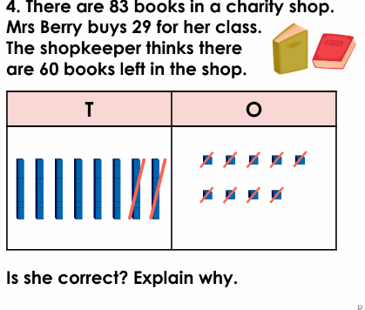
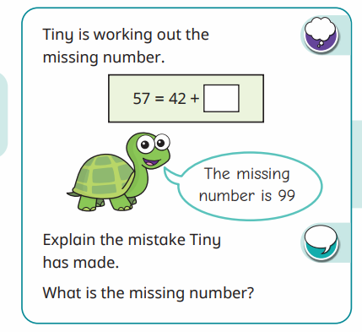
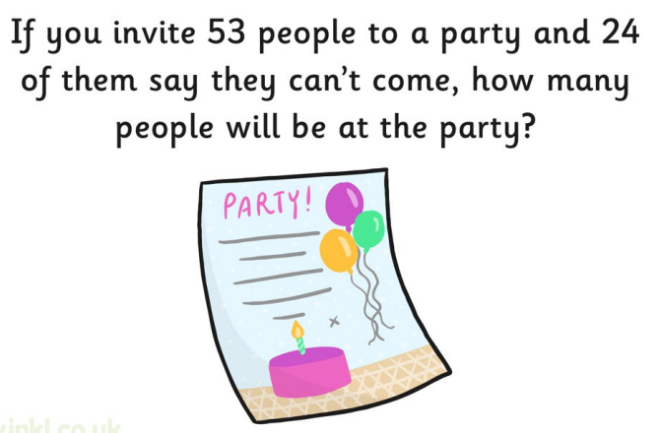
Problem solving and reasoning questions linked to subtraction…

Slide 15
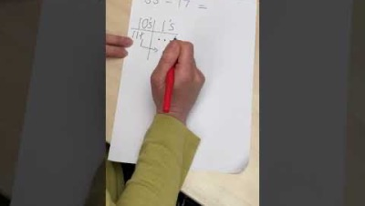
Video explaining subtraction strategies
Click here to view the view the video in YouTube: https://youtu.be/5XwGSCTZIjM

Slide 16
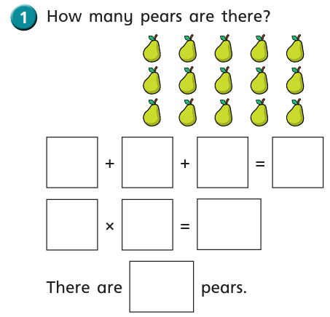
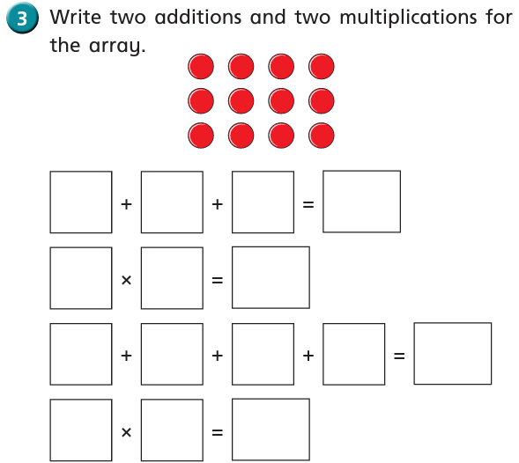
Examples of multiplication questions …

Slide 17
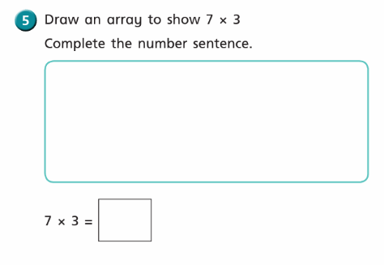
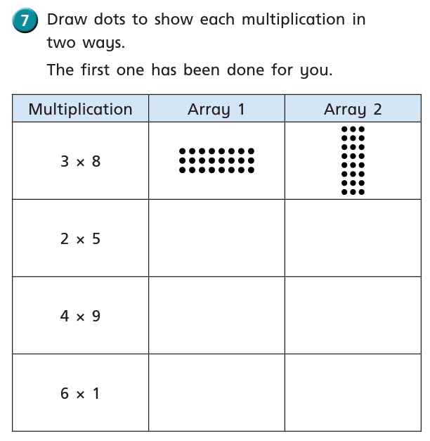
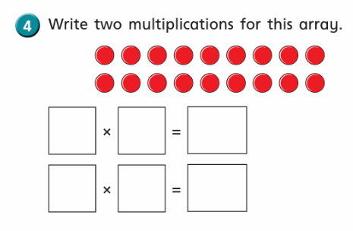

Slide 18
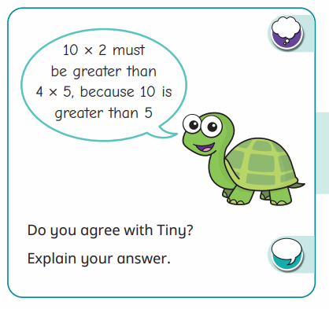
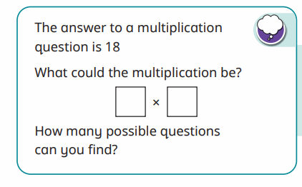
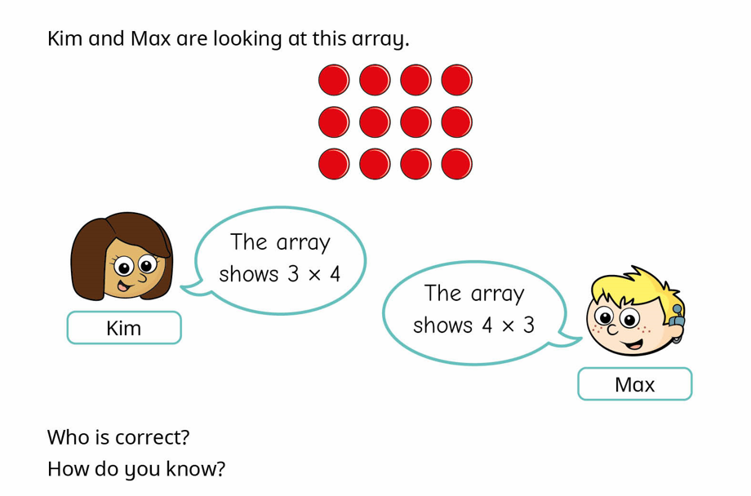
Problem solving and reasoning linked to multiplication…

Slide 19
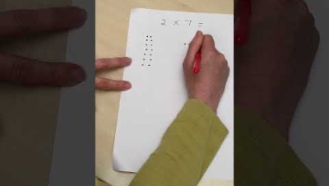
Video explaining multiplication strategies
Click here to view the view the video in YouTube: https://youtu.be/doH785CA_1o

Slide 20
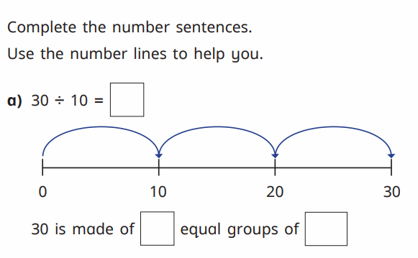
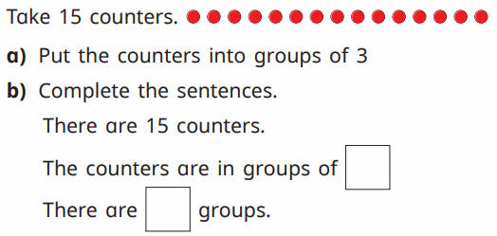
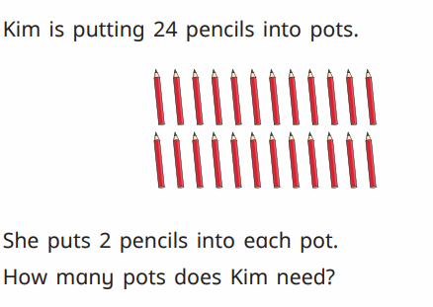
Questions linked to division- grouping and sharing …
Grouping

Slide 21
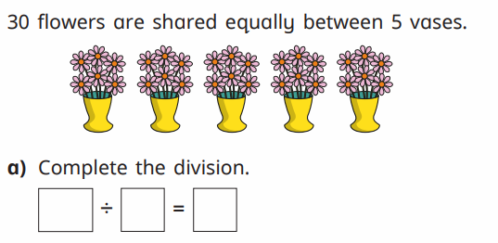
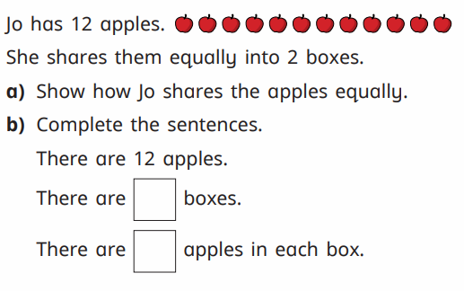
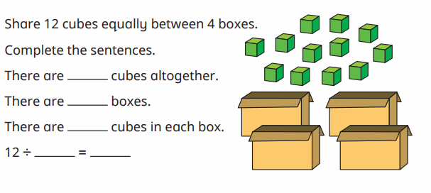
Sharing…

Slide 22
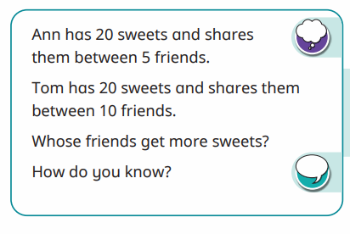
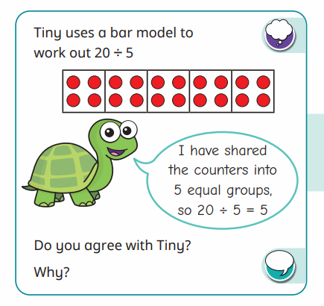
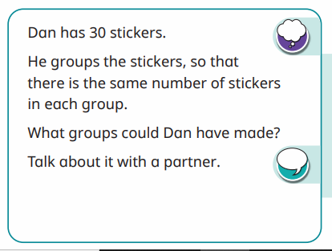
Problem solving and reasoning questions linked to division….

Slide 23
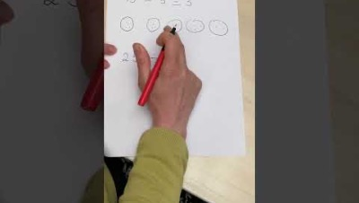
Video explaining division strategies
Click here to view the view the video in YouTube: https://youtu.be/R971iZig11E

Slide 24

Any questions?

